Slide 1


Empowering the World Through Cybersecurity, Secure Clean Energy & IT Intelligence
Copyright REM Technology Consulting Services 2019

Slide 2
About the Company
REMTCS, Inc. is a leading provider of technology products and services across a broad spectrum of industry verticals.
REMTCS was founded in 1993 by Richard Malinowski, and includes a team of cybersecurity, software development, and energy sector veterans who share a passion for delivering high quality and cost-effective solutions to our clients.
For over 25 years REMTCS has been implementing successful projects ranging from global infrastructure upgrades, implementing operational risk management systems, to designing and integrating campus scale energy resiliency solutions. Our global experience includes:
The design and implementation of 58 trading floors worldwide.
Three of the largest datacenters in the world.
Comprehensive cybersecurity programs for some of the most prominent commercial and defense companies in the market.

Slide 3
What We Do
Our success continues today with our core areas of focus:
Cybersecurity products leveraging artificial intelligence and behavioral analysis.
Design and implementation of grid connected and non-wires secure microgrid solutions with integrated cybersecurity and EMP protection.
Advisory services in the areas of cybersecurity, compliance, management, and operational effectiveness.
Quantitative Analytic Modeling for Financial Services.

Slide 4
Cybersecurity
Distributed Cloud Architectures and on-demand IT have created additional layer of complexity in cybersecurity for todays leaders. Companies are fumbling with up to 45 diverse security systems to coordinate and manage. REMTCS has the solution.

Slide 5
REMTCS Organizational Considerations to Mitigate Risk
Secure Configuration
Engineered to establish baseline technology integration/processes to reduce risk of compromise.
Continuous Proactive Monitoring:​
​
Autonomously detect attacks and appropriately respond with countermeasures in real-time. Ensures adherence with policies, and legal/regulatory compliance.
Determine Risk
Threshold
Threat Intrusion and Malware Prevention:​
Implementation of layered cybersecurity approach along with correlating policies to protect against malicious code or content.
Managing Users Access and Privileges:​
​
Utilization of biometrics for identification and authentication with defined user privileges and procedures, Limit the risk of compromised privileged credentials.
Implement Strategies & Policies
Identify Cyber Risk Potential
Network Protection:​
​
Ensuring your network is not exposed to attackers, including access from partners and customers, onsite or remote locations.
Awareness, Advisory, Training:
​
Identify cyber vulnerabilities, including user exploitation. Proper technology testing and user training with policies to mitigate risk.
Custom VPN for Mobile and Remote Access
​
Combination of user training, secured connections, and threat protection software.

Slide 6
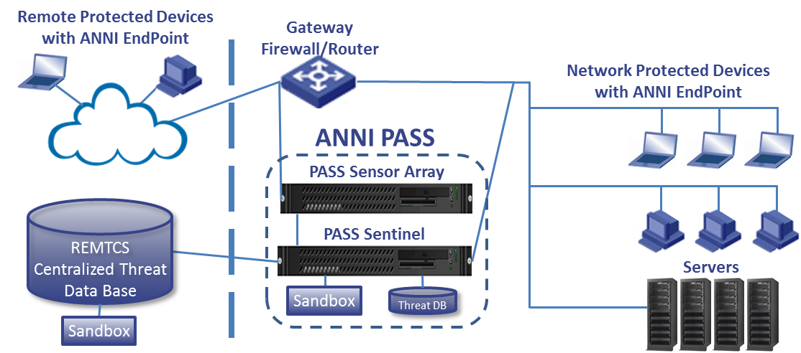
PASS Cybersecurity System
Patented, Fully Autonomous Secure End-to-End Purpose Built Hardware Appliance and End-Point System
Proactively Identifies & Defends BEFORE Networks and Systems are Compromised
A Layered Approach to Protecting Organizations and People from Cyber Threats
The PASS solution operates as an advanced Unified Threat Management (UTM) system in order to offer complete protection, negating the need to source multiple vendors, and ensuring networks are not exposed while also offering substantial cost benefits.
PASS combines the continuous monitoring and reporting benefits of an intrusion detection system (IDS), with the response and control capabilities to take actions against potentially malicious data packets of an intrusion prevention system (IPS). The finely tuned IPS configuration allows legitimate traffic to traverse the network to reduce false positives.

Slide 7




Patented fully autonomous behavioral analysis utilizing a series of proprietary artificial intelligence algorithms
Predictive/Proactive Prevention
Enables near real-time, proactive blocking and provide rich and actionable intelligence to better understand the nature of attacks for continuous improvement of the security posture. Continuous real-time learning of malware and variants by design and method.
Detection
Today's advanced threats require an architecture that is aware of the multi-stage and multi-vector nature of attacks. Our PASS system detects known and unknown threats in near real-time and can scale with the demands of the network.
PROACTIVE
Discovers, reverse engineers/creates a signature with 5 to 12+ variants that hunts down and destroys malware across the entire enterprise.
FULLY AUTONOMOUS
Deep Inspection of every packet of data traversing the network and making informed decisions without the need for human intervention.
NEAR REAL-TIME
Continuous monitoring and execution 24 X 7 X 365 to make near-real time decisions.
Containment
Near real-time validation of threats coupled with the ability to rapidly stop the impact of an attack on compromised systems. Automated quarantine and reverse engineering of found malware.
Remediation
Automated deployment of network and endpoint countermeasures to mitigate spread and damage of found malware. Near real-time validation of threats coupled with the ability to rapidly stop the impact of an attack on compromised systems.

Slide 8

HOW IT WORKS…
Patented Artificial Intelligence Algorithms, detect patterns.
Each end-point/client utilizes the endpoint anti-malware application installed containing the latest threat intelligence and counter-measures which scans and destroys malware.
If malware is detected, PASS captures the IP address of requesting client and contains the malware, decompiles, scrubs, inoculates and destroys the malware across all network elements including the requesting client machine.
Additionally, new malware that is detected, new countermeasures are pushed out to network elements for proactive remediation.
All in Near Real-Time
If PASS knows the data patterns, she'll know the relationship between data elements.
When PASS understands the relationship, then she'll know the context of the element.
If PASS knows the context, then she'll understand the meaning of "why, what, & how" of the data or pattern.
PASS creates a decision tree
PASS deploys countermeasures to solve the problem

Slide 9
Patented Artificial Intelligence (AI) Capabilities
  Learn & Detect Variations of known threats through Behavioral Analysis
Type 2: Behavioral Analysis
Type 3: Autonomous Decision Trees
Contextual Understanding
Autonously Forms Associations
REMTCS PASS APPLIANCE
  Contextual Awareness through Machine Learning: achieves optimal learning patterns by detecting patterns and associations
  Identify New or Unknown Threats
Type 1: Semantic Search
Type 4: Deep (Self) Learning
Database (Static)
Human Characteristics
(In Development)

Slide 10
System Features
Benefits
Built on a High-Performance Computing Appliance
Driven by Artificial Intelligence & Behavioral Analytics
True End-to-End System that incorporates Internal Threat Protection
Compliments existing security systems and platforms:
  Integrates with existing firewalls to automatically deploy blocking rules.
  Integrates with MS Active Directory to contain compromised accounts.
  Additional countermeasures.
  Deep inspection of all packets traversing the network.
Reduce TTD (Time To Detect) from 6 months to 2-15 minutes
Reduce TTR (Time To Remediate) from 12 months to 2-15 minutes
Detects new forms of malware/Zero Day
Predicts potential threats and evolving threats
Leverages your existing security investments and resolves 95%+ False Positives day one.
Gives your security teams and incident responders time to focus on what’s critical by automatically and autonomously identifying, capturing, containing and destroying malware attacks. Saves 1,000’s of man-hours per year.
In EVERY instance that PASS has been deployed, she has found undetected malware that had infected systems for months.

Slide 11
Digital Rights Management

Slide 12
REMTCS Digital Rights Management (DRM)
Protection and Controlled Distribution of Commercialized Digital Video Products
REMTCS DRM Protects Against Piracy and Copyright Infringement
REMTCS DRM protects files including, but not limited to, video, audiobook, and PDF.
Platform Agnostic (Files Work on any Device w/o Software)
Videos are Created Uniquely for each Customer Preventing Re-Distribution
Files are Locked to a Single Device
Files are Encrypted and Signed with a Quantum Resilient Signature During Transit and Decrypted when Payment is Authorized
Files are Decrypted a Single Time vs. Constantly with our Competitors
Every Download and View is Logged Presenting an Opportunity for New Revenue Recognition Models

Slide 13
Secure Energy Solutions

Slide 14

REMTCS Energy Solutions
REMTCS has decades of experience in designing and integrating campus scale energy resiliency solutions. Our expert engineers will review client's requirements and goals and develop custom solutions that integrate a variety of energy efficient technologies including renewable energy sources and battery energy storage systems.
Benefits Include:
Decreased reliance on utility power.
Providing instantaneous back-up power without data loss.
Resolves electrical spikes, harmonics, and synchronization issues.
Significant cost-savings by reducing utility demand charges and supplying stored power during peak charge times. Typical cost savings range from 30%-50%.

Slide 15
Customizable and scalable battery storage for varying applications across multiple segments including commercial, industrial, utility energy storage and micro grid operations.
ENERGY STORAGE SYSTEMS (ESS)
ADVANCED CONTROLLER AND ENERGY MANAGEMENT (EMOS)
REMTCS can design an energy storage system to fit the needs and requirements for varying projects.
Using high performance inverters as the building blocks of a system, we can integrate several battery technologies including, but not limited to lithium ion, large format lithium iron, sealed lead acid, and hybrid batteries for smart grid and microgrid applications.
Our EMOS is a high performing and reliable PC-based hardware and software solution. With real-time, web-based monitoring and control, administrators have access to critical operating data of the ESS and microgrid.
The EMOS allows for scalability and can aggregate data from multiple stations of an installation offering a single point of control to maximize energy efficiency and reduce utility costs.

Slide 16
Features incorporated in our module PowerGrid design:
High redundancy through independent battery building blocks (all systems are masters – i.e. voltage forming)
Scalable – easily parallelable battery systems without requirement for Master-Slave configuration
Option to add PV, Geothermal, Closed Loop Systems, directly to the DC-link (DC coupled PV) for PV self-consumption or even PV export
Option to add backup generators for extended backup durations
Option to provide demand reduction & peak shaving ancillary services
Fully microgrid capable – allows adding more distributed energy sources to scale to client needs for future considerations
Optional outdoors package - pad installation with thermally managed enclosures

Slide 17
REMTCS Secure Energy Solutions
REMTCS Provides Solutions to Protect Investments in Microgrid Technologies.
  PASS system tailored to grid applications for the ultimate in control system cybersecurity
  Military grade VPN system that connects grid, components, and SCADA
  Custom designed EMP protection from solar storms, spikes, and man-made events
PASS Network Protection

Slide 18
Advisory Services

Slide 19
REMTCS Government Contractor Advisory Services
Assisting businesses of all sizes with establishing or revising security and risk management processes.
NISPOM
DFARS
ITAR/EAR
  Assessment/Audit of NISPOM (general) and/or NIST 800-53r4 (InfoSec) controls
  Development and integration of a FOCI mitigation program
  Advisory services for Facility Security Officers (FSO)s in navigating DSS and NISPOM requirements
  Assessment/Audit of NIST 800-171 Information Security Controls
  Development of DFARS compliant System Security Plans (SSP)
  Implementation of InfoSec Controls on Contractor Systems
  Assessment / Development of Import/Export Control Program
  Development of Technology Control Plans (TCP)
  Development of Electronic Communication Plans (ECP)

Slide 20
THANK YOU
Contact Us!
www.remtcs.com
For more information, please contact our Sales Team at:
Email: sales@remtcs.com
Phone: 877-381-9696 Option 2

